Slide 1

Derivative Derivative of a Power
RCET 0264 Introductory Calculus
Tim Leishman

Slide 2
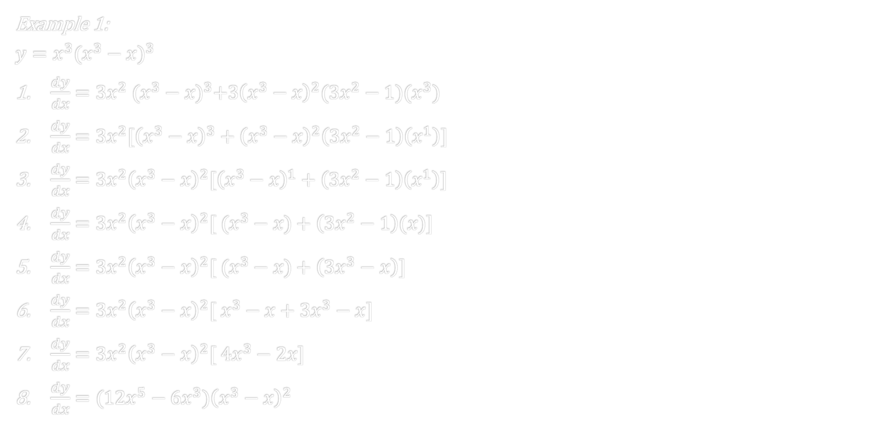
Derivative of a Power
Example 1:
$$y=x^{3}{(x^{3}−x)}^{3}$$
$\frac{dy}{dx}=3x^{2} {(x^{3}−x)}^{3}+3{\left(x^{3}−x\right)}^{2}(3x^{2}−1)(x^{3})$
$\frac{dy}{dx}=3x^{2}[{\left(x^{3}−x\right)}^{3}+{\left(x^{3}−x\right)}^{2}\left(3x^{2}−1\right)\left(x^{1}\right)]$
$\frac{dy}{dx}=3x^{2}{\left(x^{3}−x\right)}^{2}[{\left(x^{3}−x\right)}^{1}+\left(3x^{2}−1\right)\left(x^{1}\right)]$
$\frac{dy}{dx}=3x^{2}{\left(x^{3}−x\right)}^{2}[ (x^{3}−x)+\left(3x^{2}−1\right)(x)]$
$\frac{dy}{dx}=3x^{2}{\left(x^{3}−x\right)}^{2}[ (x^{3}−x)+\left(3x^{3}−x\right)]$
$\frac{dy}{dx}=3x^{2}{\left(x^{3}−x\right)}^{2}[ x^{3}−x+3x^{3}−x]$
$\frac{dy}{dx}=3x^{2}{\left(x^{3}−x\right)}^{2}[ {4x}^{3}−2x]$
$\frac{dy}{dx}=(12x^{5}−6x^{3}){\left(x^{3}−x\right)}^{2}$

Slide 3
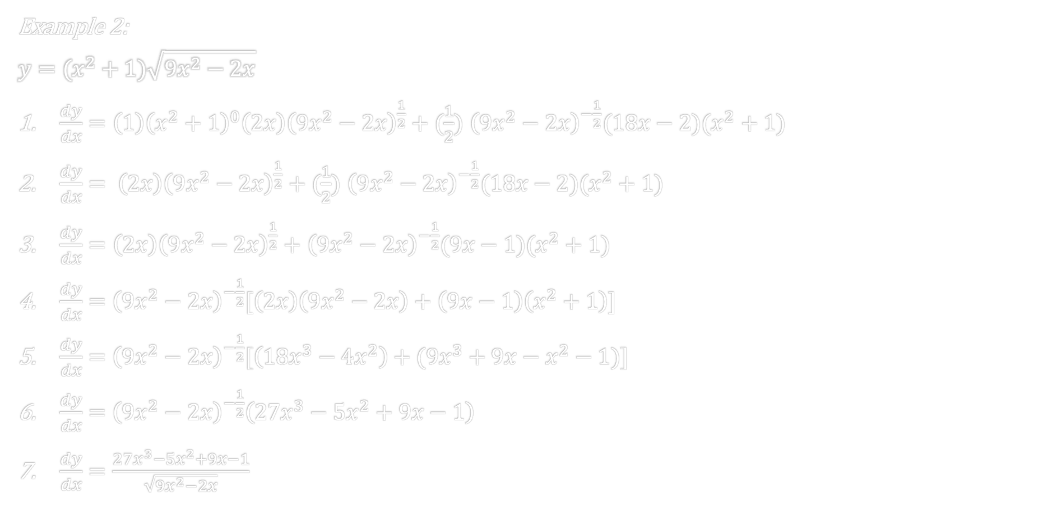
Derivative of a Power
Example 2:
$$y=(x^{2}+1)\sqrt{{9x}^{2}−2x}$$
$\frac{dy}{dx}=\left(1\right){\left(x^{2}+1\right)}^{0}\left(2x\right){\left(9x^{2}−2x\right)}^{\frac{1}{2}}+(\frac{1}{2})$ ${\left(9x^{2}−2x\right)}^{−\frac{1}{2}}(18x−2)(x^{2}+1)$
$\frac{dy}{dx}= \left(2x\right){\left(9x^{2}−2x\right)}^{\frac{1}{2}}+(\frac{1}{2})$ ${\left(9x^{2}−2x\right)}^{−\frac{1}{2}}(18x−2)(x^{2}+1)$
$\frac{dy}{dx}=\left(2x\right){\left(9x^{2}−2x\right)}^{\frac{1}{2}}+$ ${\left(9x^{2}−2x\right)}^{−\frac{1}{2}}(9x−1)(x^{2}+1)$
$\frac{dy}{dx}=$ ${\left(9x^{2}−2x\right)}^{−\frac{1}{2}}[\left(2x\right)\left(9x^{2}−2x\right)+\left(9x−1\right)\left(x^{2}+1\right)]$
$\frac{dy}{dx}=$ ${\left(9x^{2}−2x\right)}^{−\frac{1}{2}}[\left(18x^{3}−4x^{2}\right)+({9x}^{3}+9x−x^{2}−1)]$
$\frac{dy}{dx}=$ ${\left(9x^{2}−2x\right)}^{−\frac{1}{2}}\left(27x^{3}−5x^{2}+9x−1\right)$
$\frac{dy}{dx}=\frac{27x^{3}−5x^{2}+9x−1}{\sqrt{{9x}^{2}−2x}}$

Slide 4

Derivative of a Power
Example 3:
$$y={(3x+4)}^{\frac{3}{4}}(4x^{2}+8)$$
$\frac{dy}{dx}=\left(\frac{3}{4}\right){\left(3x+4\right)}^{−\frac{1}{4}}\left(3\right)\left(4x^{2}+8\right)+8x{(3x+4)}^{\frac{3}{4}}$
$\frac{dy}{dx}=$ ${\left(3x+4\right)}^{−\frac{1}{4}}[\left(\frac{9}{4}\right)\left(4x^{2}+8\right)+8x\left(3x+4\right)]$
$\frac{dy}{dx}=$ ${\left(3x+4\right)}^{−\frac{1}{4}}[\left(9x^{2}+18\right)+(24x^{2}+32x)]$
$\frac{dy}{dx}=$ ${\left(3x+4\right)}^{−\frac{1}{4}}\left(33x^{2}+32x+18\right)$
$\frac{dy}{dx}=$ $\frac{33x^{2}+32x+18}{{\left(3x+4\right)}^{\frac{1}{4}}}$

Slide 5
References:
Ewen, D., Gary, J. S., & Trefzger, J. E. (2005). Technical calculus. Upper Saddle River, NJ: Pearson/Prentice Hall.
Richmond, A. E., & Hecht, G. W. (1995). Calculus for electronics. New York: Glence.
https://www.desmos.com

